Slide 1

CB Gym Rats

Slide 2
TABLE OF CONTENTS
1. Our Team
2. Stages of realization
3. Used technologies

Slide 3
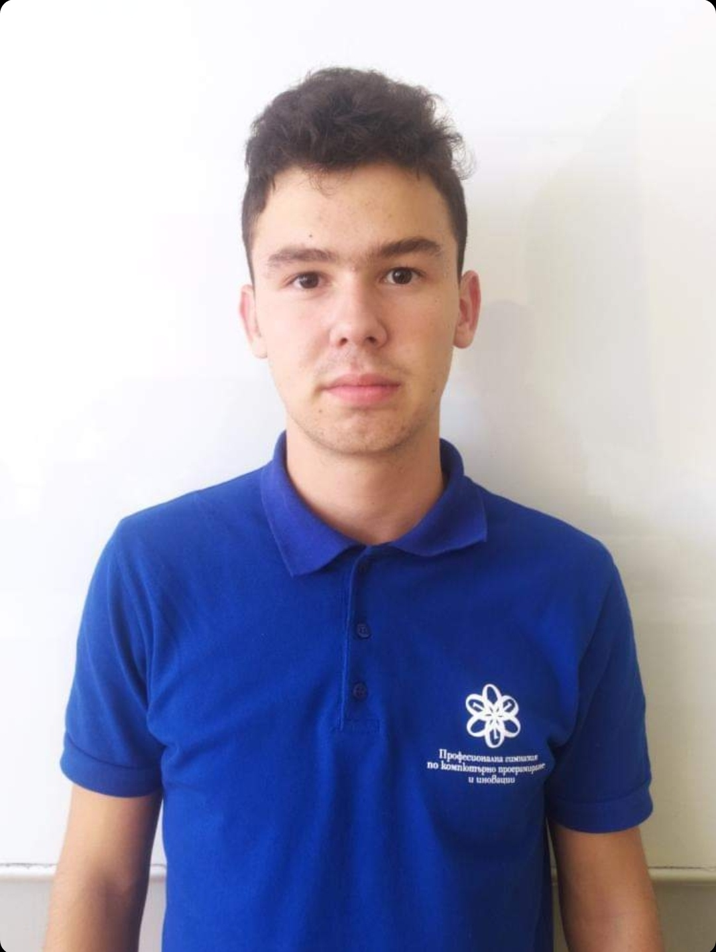
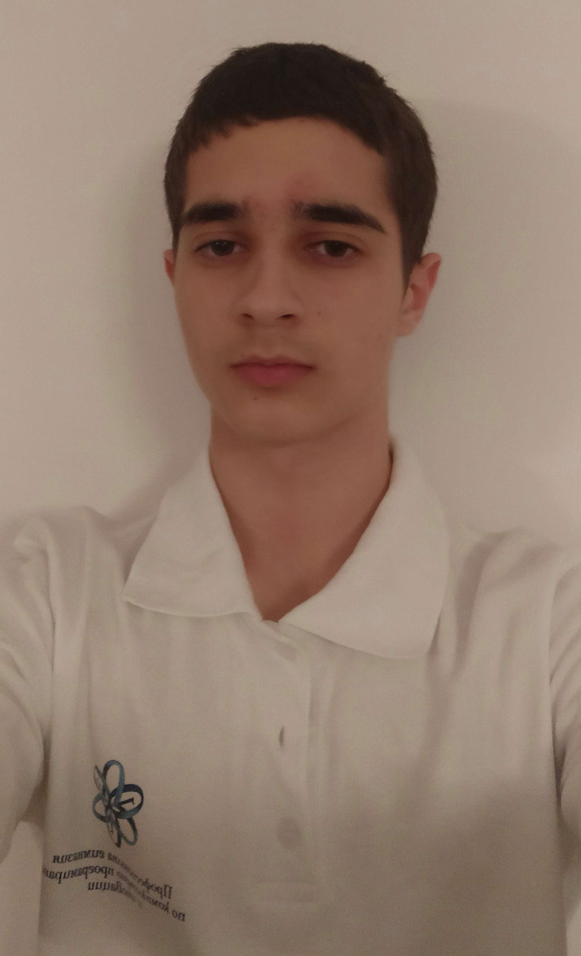
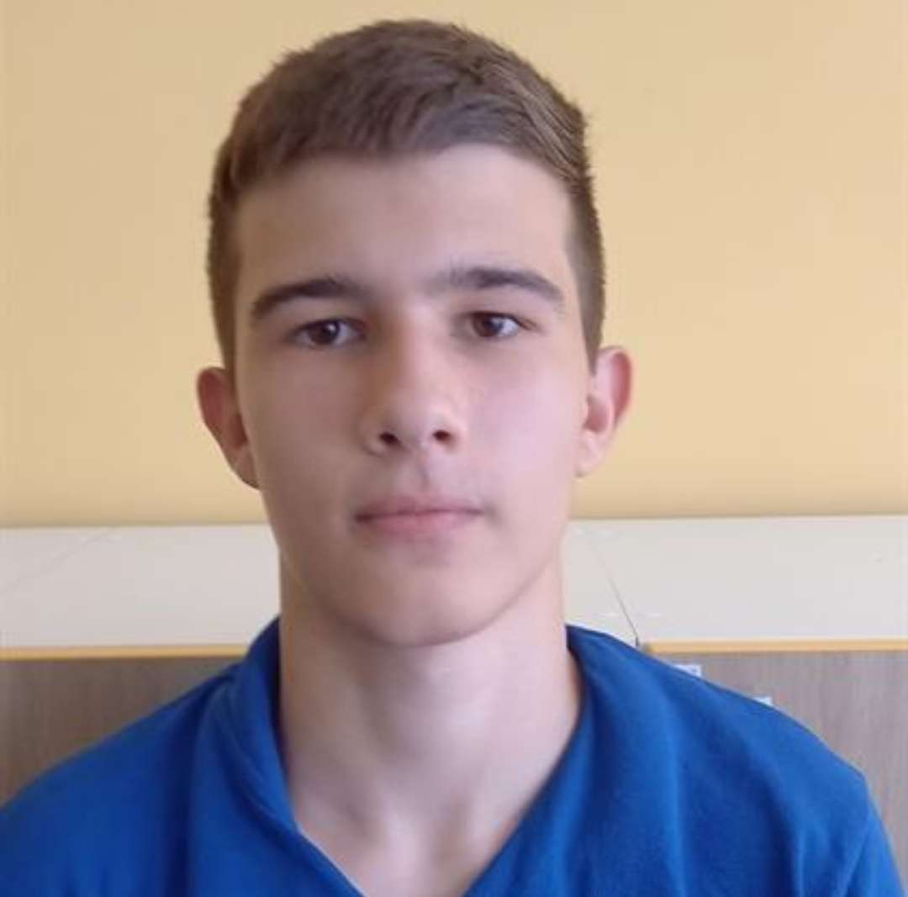
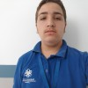
Our Team
Kaloyan Georgiev IX^{V}
Scrum Trainer
Ivailo Buchvarov IX^{B}
Back-End Developer
Georgi Filipov IX^{G}
Front-End developer
Simeon Syarov IX^{A}
QA Engineer

Slide 4



Stages of realization

Slide 5








Used technologies

Slide 6
Now let’s go to our repository!

